Slide 1
INTRODUCTION TO INTRUSION DETECTION SYSTEM
MODULE 1

Slide 2
CONTENTS
1.1. Intruders
1.2. Classes of Intruders
1.3. Examples of Intrusion
1.4. IDS Principles
1.5. IDS Requirements
1.6. Host-Based IDS
1.7. Network-Based IDS
1.8. IDPS Methodologies
1.9. Types of Threats

Slide 3
INTRUDERS
A significant security problem for networked system is unwanted trespass by users or software.
1)User trespass: Unauthorized login to a machine, acquisition of privileges or performance of actions beyond those that have been authorized.
2) Software trespass: Form of a virus, worm or Trojan Horse.

Slide 4
Classes of Intruders
There are three classes of Intruders:
Masquerader- An individual who is not authorized to use the computer and who penetrates a system’s access controls to exploit a legitimate user’s account.
Misfeasor- A legitimate user who accesses data, programs or resources for which such access is not authorized, or who is authorized for such access but misuses his or her privileges.
Clandestine User- An individual who seizes supervisory control of the system and uses this control to evade auditing and access controls or to suppress audit collection.

Slide 5
Examples of Intrusion
Remote root compromise
Web server defacement
Guessing / cracking passwords
Copying viewing sensitive data/databases
Running a packet sniffer
Distributing pirated software
Using an unsecured modem to access net
Impersonating a user to reset password
Using an unattended workstation

Slide 6
IDS Principles
Assume intruder behavior differs from legitimate users
Expect overlap as shown
Observe deviations from past history
Problems of:
False Positives
False Negatives
Must Compromise

Slide 7
IDS Requirements
Run continually
Be fault tolerant
Resist subversion
Impose a minimal overhead on system
Configured according to system security policies
Adapt to changes in system and users
Scale to monitor large number of systems
Provide graceful degradation of service
Allow dynamic configuration

Slide 8
Host-Based IDS
Specialized software to monitor system activity to detect suspicious behavior
Primary purpose is to detect intrusions, log suspicious events and send alerts.
Can detect both internal and external intrusions
Two approaches, often used in combination:
Anomaly detection – Defines normal/expected behavior
Threshold Detection
Profile Based
Signature detection – Defines proper behavior

Slide 9
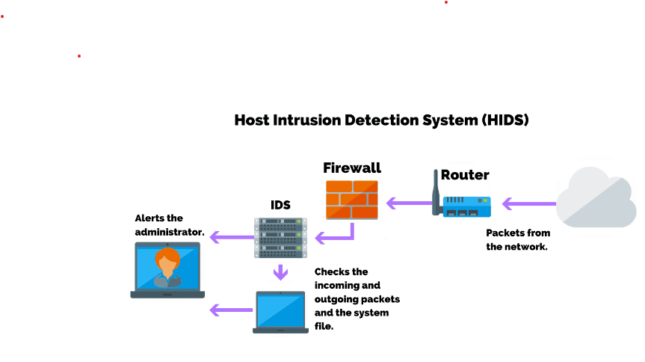
How HIDS work??

Slide 10
Anomaly Detection
Threshold Detection
Checks excessive event occurrences over time
Alone a crude and ineffective intruder detector
Must determine both thresholds and time travels
Profile based
Characterize past behavior of users/groups
Then detect significant deviations
Based on analysis of audit records

Slide 11
Signature Detection
Observe events on system and applying a set of rules to decide if intruder
Approaches:
Rule-based anomaly detection
Analyze historical audit records for expected behavior, then match with current behavior
Rule-based penetration identification
Rules identify known penetrations/weaknesses
Often by analyzing attack scripts from Internet
Supplemented with rules from security experts

Slide 12
There are many threats that can be eliminated with the help of a host-based IDS:
Malicious Attacks- Such as unauthorized authentication attacks, HIDS detects the attack and sends it for analysis.
Asymmetric Routing- When data packets traveling through the network take a particular route to their destination and take a different route back, it is called asymmetric routing. This mechanism allows the attackers to perform a DDOS attack. HIDS helps determine such routes

Slide 13
Buffer Overflow Attacks- This kind of attack attempts to infiltrate segments of memory in the device on which the host-based IDS is installed.
Scanning Attacks- Scanning attacks involve sending data to the network to collect data about the network, traffic, ports, and hosts. HIDS will help minimize these attacks using advanced features such as a web application firewall to protect the data within the system.

Slide 14
Network-Based IDS
Network-based IDS (NIDS)
Monitor traffic at selected points on a network
In real time to detect intrusion patterns
May examine network, transport and/or application level protocol activity directed towards systems
Comprises a number of sensors
Inline (possibly as part of other net device)
Passive (monitors copy of traffic)

Slide 15
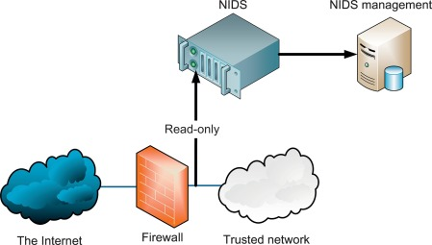

Slide 16
NIDS Sensor Deployment
Inline sensor
Inserted into a network segment so that the traffic it is monitoring must pass through the sensor
Passive sensor
Monitors a copy of network traffic

Slide 17
NIDS- Intrusion Detection Techniques
Signature Detection
At application, transport, network layers; unexpected application services, policy violations
Anomaly Detection
Of Denial of Service Attacks
When potential violation detected sensor sends an alert and log information
Used by analysis module to refine intrusion detection parameters and algorithms
By security admin to improve protection

Slide 18
Anomaly based Methodology Architecture
Anomaly based methodology works by comparing observed activity against a baseline profile.
The baseline profile is the learned normal behaviour of the monitored system and is developed during the learning period were the IDPS learns the environment and develops a normal profile of the monitored system.

Slide 19
Uses three general techniques for detecting anomalies:-
Statistical Anomaly Detection- The threshold or profile must be tuned according to the requirements and behaviour of the environment being monitored for the systems to be effective.
Knowledge/data-mining- Monitor searches for anomalies and this process places a very high overheard on the system
Machine learning based- Works by analyzing the system calls

Slide 20
CONTT..
The monitored environment is monitored by the detector that examines the observed events against the baseline profile.
If the observed events match the baseline, no action is taken, but if it does not match the baseline profile and it is within the acceptable threshold range then the profile is updated.
If the observed events do not match the baseline profile and falls outside the threshold range they are marked as an anomaly and alert is issued.

Slide 21
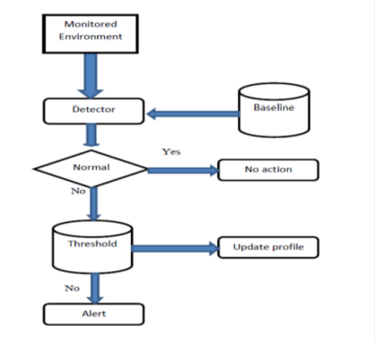
Anomaly based Methodology Architecture

Slide 22
Signature based Methodology Architecture
Signature based methodology works by comparing observed signatures to the signatures on file. This file can be database or a list of known attack signatures.
The signature based IDPS has little overhead since it does not inspect every activity or network traffic on the monitored environment. Instead it only searches for known signatures in the database or file.
Easy to deploy as no need to learn the environment.

Slide 23
Signature based methodology is very effective against know attacks/violations but it cannot detect new attacks until it is updated with new signatures
Signature based IDPS are easy to evade since they are based on known attacks and are depended on new signatures to be applied before they can detect new attacks
Signature based detection systems can be easily bypassed by attackers who modify known attacks and target systems that have not been updated with new signatures that detect the modification.
Requires significant resources to keep up with the potential infinite number of modifications to known threats.
Simpler to modify and improve since its performance is mainly based on the signatures or rules deployed.

Slide 24
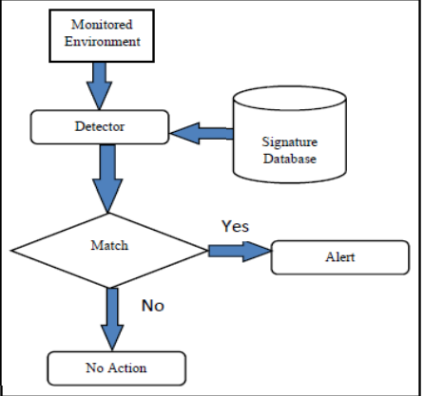
Signature based Methodology Architecture

Slide 25
CONTT…
This architecture uses the detector to find and compare activity signatures found in the monitored environment to the known signatures in the signature database. If a match is found, an alert is issued and there is no match the detector does nothing.

Slide 26
Stateful Protocol Analysis based Methodology Architecture
The Stateful protocol analysis methodology works by comparing established profiles of how protocols should behave against the observed behaviour.
Stateful protocol analysis has a deep understanding of how the protocols and applications should interact/work. This deep understanding/analysis places a very high overhead on the systems.

Slide 27
CONTT..
This architecture is identical to that of the signature based methodology with one exception, instead of the signature database the Stateful protocol analysis has database of acceptable protocol behaviour.

Slide 28
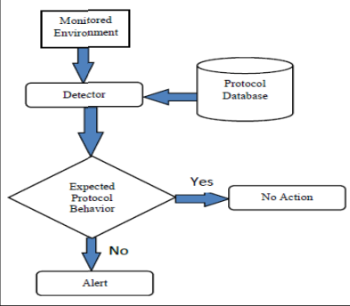
Stateful Protocol Analysis based Methodology Architecture

Slide 29
Hybrid based Methodology Architecture
The hybrid based methodology works by combining two or more of the other methodologies.
Prelude is one of the first hybrid IDS that offered a framework based on the Intrusion Detection Message Exchange Format (IDMEF) that allows different sensors to communicate.
A general over view of a hybrid based methodology is shown in Figure. Three other methodologies are combined. The monitored environment is analyzed by first methodology and passed to the next and then the last one. This produces a better system.

Slide 30
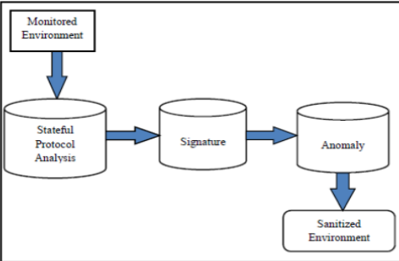
Hybrid based Methodology Architecture

Slide 31
Parameters | Anomaly | Signature | Stateful Protocol Analysis | Hybrid
Resistance to Evasion | Medium | Low | Low | High
High accuracy rate | Medium | Medium | Medium | High
Scalability | Medium | High | High | Medium
Easy to Configure | No | Yes | Yes | No
Overhead on Monitored System | Medium | Low | Low | Medium
Maintenance | Low | Medium | Medium | Medium
Performance | Medium | High | High | Medium
Protection against New attacks | High | Low | Medium | High
Easy to Use | Medium | Low | Low | Low
False Positive | High | Low | Low | Low
False Negative | High | Medium | Medium | Low

Slide 32
TYPES OF THREATS
There are two types of threats:-
Internal Threat- Refers to risk of somebody from inside the company who can exploit a system to cause damage or steal data.
External Threat- Any potential danger or risk that originates from outside an organization.

Slide 33
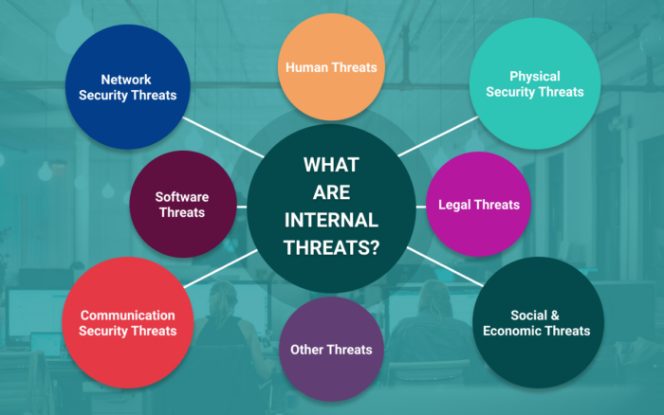

Slide 34
INTERNAL THREAT
As employees of any organization have the privilege of accessing physical equipment and documents, without appropriate security measures they can purposely cause damage. Eg- Yahoo email leaks, Company was subject to the largest data breach on record.
Accidental data loss and data breach are quite common. Around 95% of security breaches happen due to human errors.
The common example we see is the people leaving their laptops accidentally in train and buses while travelling, or accidentally deleting data from a folder, or spilling a drink on devices.

Slide 35
CONTT..
An organization’s servers are left unlocked in a room, there are high chances anybody could walk into the room and steal crucial information.
Even ordinary employees of the organization can also exploit the vulnerabilities accidentally by viewing anything on a malicious website. They may unintentionally download a virus and cause harm to the entire network.

Slide 36
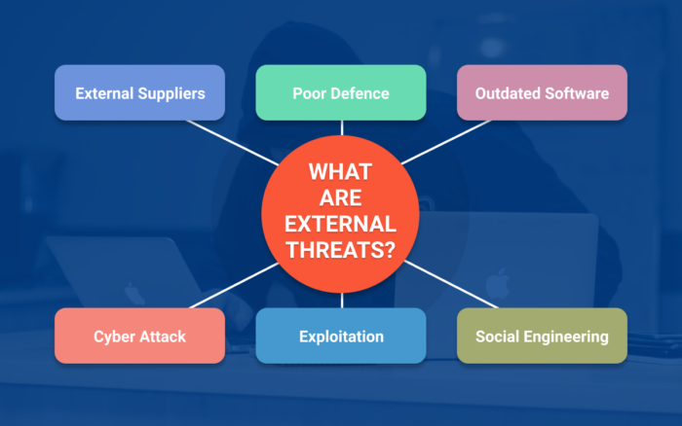

Slide 37
EXTERNAL THREAT
External attacks are harder to deal with than internal threats because you have no control over people outside your organization.
Its better to understand the intensity of attacks, organizations need to know the entry points from where these attacks can take place.
Some software is less harmful while some have the potential to destroy a network. The common examples include spyware, adware, ransomware, worms, Rootkits, and Trojans.

Slide 38
CONTT..
Outsiders can launch an attack through hacking.
Lack of knowledge regarding cyber-attacks and unsafe practices can lead to cybercrimes. Social engineering is the biggest example where bank frauds and identity frauds happen.
A phishing email is a common form where a bot or a person sends an email pretending to be in an authoritative position in any organization asking for confidential data.

Slide 39
CONTT..
Considering both internal and external threats, we realize that both are devastating for any organization. However, it depends on the industry and intention behind carrying out an attack.
External threats are equally dangerous and are often a priority when data security is concerned.
Most outsider attacks attempt to manipulate data and take advantage of a company’s structure, resources, employees, and information. Thus, organizations need to inspect the network perimeters.
We can prevent any attack that could stem from the inside by following strict policies and security measures.

Slide 40
How to protect company from threats?
Consider a risk-based approach by addressing each problem individually. This way, we will know the priorities and reach an informed decision that can be cost-effective and gives you the best results.
Make sure to restrict the sharing of passwords and other credentials through any means whether emails, messages, Skype, or any communication channel as a part of cyber security measures.
Always remove ex-employees data access rights and eliminate any data access controls after keeping a backup file of the data.

Slide 41
CONTT..
Consider automating everything by implementing automation programs that include filtering, detecting, and sending alerts based on keywords to check for any unusual activities. However, don’t completely rely on automation; instead, use a mix of both. Traditional methods that include background checks of employees and pre-employment screening are also important.
Recommended to conduct risk assessments, insider threat analysis, and ensure proper implementation of security management practices.

